Slide 1
Staying relevant in the 4IR and avoiding manager armageddon
Dr Ian Clarkson, FLPI
Head of Organisational Consultancy, QA

Slide 2
THE MAJOR CHALLENGE WE FACE?
”
“The world’s most serious short-term
(five-to-10-year) problem is declining economic dynamism and declining productivity (GDP per capita)…
…the defects that need to be eliminated aren’t failures in process but failures in maximising human potential.
Source: It’s the Manager, Jim Clifton & Jim Harter, Gallup

Slide 3



THE TRIPLE WHAMMY OF MANAGER ARMAGEDDON
“65% of children entering primary school today will ultimately end up working in completely new job types that don’t yet exist”
World Economic Forum. The Future of Jobs Report 2016
“…most people will not suffer from exploitation, but from something much worse – irrelevance”
21 Lessons for the 21st Century by Yuval Noah Harari
“Young talent today are motivated by different factors. They don't value long-term goals or titles”
BCG's Global Chief of Staff, Mai-Britt Poulsen, interview with Børsen where she addressed the three toughest challenges CEOs face in 2019

Slide 4
LIFTING THE MOOD…
”
“…despite a pervasive corporate focus on digital transformation, 84 percent of respondents told us they need to rethink their workforce experience to improve productivity
Source: 2019 Deloitte Global Human Capital Trends

Slide 5
I’M ALMOST HAPPY…ALMOST!
”
“Faced with relentless acceleration of artificial intelligence (AI), cognitive technologies, and automation, 86 percent of respondents believe they must reinvent their ability to learn
Source: 2019 Deloitte Global Human Capital Trends

Slide 6
FROM AUTOMATION TO AUGMENTATION…
”
“…an approach where businesses look to utilize the automation of some job tasks to complement and enhance their human workforces’ comparative strengths
Source: World Economic Forum. The Future of Jobs Report 2018

Slide 7
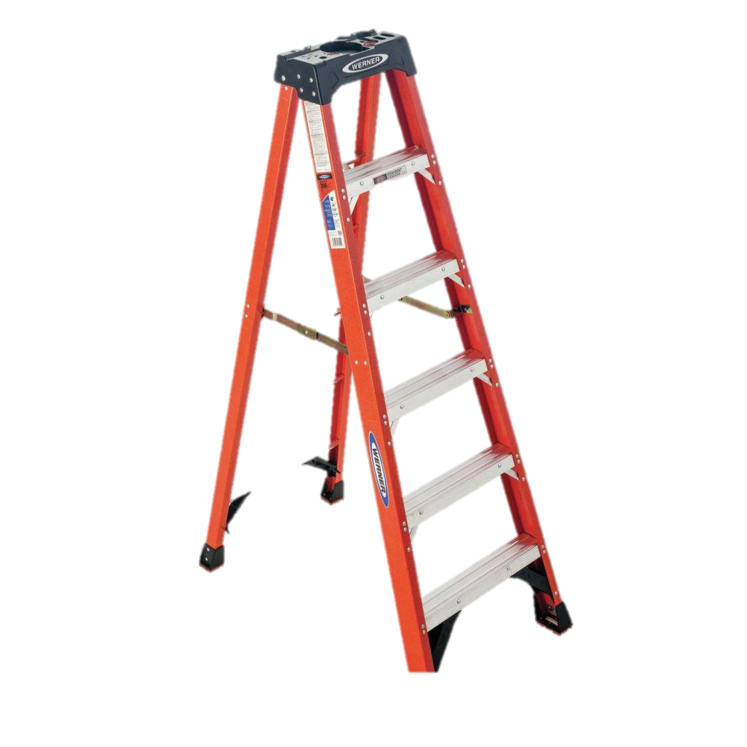

THE SOLUTION IS NOT PIE IN THE SKY…
vs
Notes:
Career lattice is a preferred model now.

Slide 8
DON’T JUST TAKE OUR WORD FOR IT…TOP 7 TALENT DEVELOPMENT FOCUS AREAS…
Identify and assess skills gaps
Increase engagement with learning programmes
Develop career frameworks
Provide consistent and valuable learning to employees globally
Train for soft skills
Deliver company specific insights to close organisational skills gaps
Understand the impact of technology and automation on skills development
Source: LinkedIn Learning 2019 Workplace Learning Report

Slide 9



THE RECIPE FOR A SUCCESSFUL LATTICE
Create the skills profiles for each role, and identify progression criteria amongst the roles
Undertake a skills gap analysis – to identify each person’s starting point
Create learning pathways - across the lattice

Slide 10
THE FUTURE OF WORK
PAST
My Paycheck
My Satisfaction
My Boss
My Annual Review
My Weaknesses
My Job
FUTURE
My Purpose
My Development
My Coach
My Ongoing Conversations
My Strengths
My Life
Source: It’s the Manager, Jim Clifton & Jim Harter, Gallup

Slide 11
BLENDED LEARNING?
INTRODUCING
CLOUD ACADEMY
Our customers told us they needed to combine the latest technology with modern curriculum design. They wanted an integrated learning experience.
WE LISTENED – ENTER CLOUD ACADEMY.

Slide 12
CONTACT
Ian Clarkson
ian.clarkson@qa.com
linkedin.com/in/ianclarkson

